Slide 1
Object Oriented Programming
Week 4
Email: abeer.gauher@nu.edu.pk
Office: CS BASEMENT 2, Office number 23

Slide 2
Contents
Finalizers, garbage collection
Arrays and ArrayLists
Variables and scope

Slide 3
What is Garbage Collection?
Memory Management technique.
Process of freeing objects.
No longer referenced by the program.

Slide 4
Why Garbage Collection?
Free unreferenced objects.
Relieves programmer from manual freeing the memory.

Slide 5
Garbage Collection in Java
Purpose
Find and delete unreachable objects.
Free space as much as possible.
When??
GC is under control of JVM.
One can request but no guarantees.
How??
Discovery of unreachable objects.

Slide 6
Garbage Collection in Java
Ways for making objects eligible for collection
Nulling a reference
Reassigning a reference variable
Using anonymous objects
Forcing garbage collection
Methods available to perform GC
Only requests and no demands
Using Runtime class
Using static methods like System.gc()

Slide 7
The garbage Collection Algorithm
The garbage collector checks to see if there are any objects in the heap that are no longer being used by the application.
If such objects exist, then the memory used by these objects can be reclaimed.
If no more memory is available for the heap, then the new operator throws an OutOfMemoryException.

Slide 8
Finalization
By using finalization, a resource representing a file or network connection is able to clean itself up properly when the garbage collector decides to free the resource's memory.
When the garbage collector detects that an object is garbage, the garbage collector calls the object's Finalize method (if it exists) and then the object's memory is reclaimed.

Slide 9
Finalization
You have no control over when the Finalize method will execute. The object may hold on to resources until the next time the garbage collector runs.
The finalize() method is invoked each time before the object is garbage collected. This method can be used to perform cleanup processing. This method is defined in Object class as:
protected void finalize(){}

Slide 10
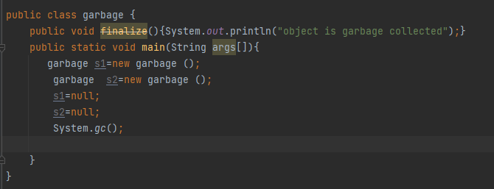

Finalization
Ways for making objects eligible for collection
Nulling a reference

Slide 11
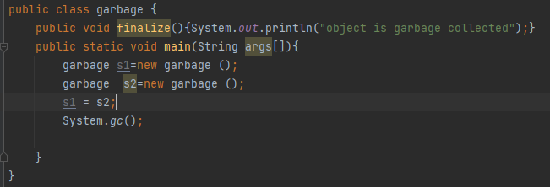
Finalization
Ways for making objects eligible for collection
Reassigning a reference variable

Slide 12
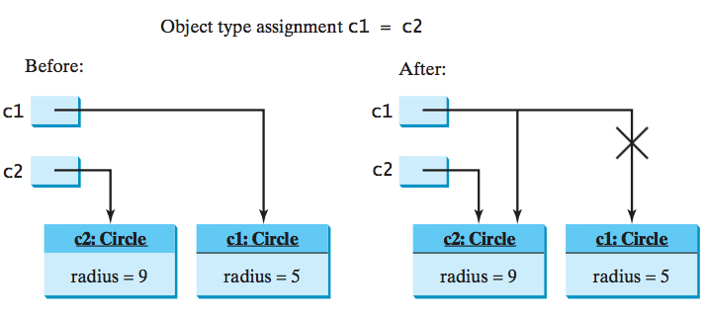
Copying Variables of Object Types

Slide 13
Garbage Collection
As shown in the previous figure, after the assignment statement c1 = c2, c1 points to the same object referenced by c2. The object previously referenced by c1 is no longer referenced. This object is known as garbage. Garbage is automatically collected by JVM.

Slide 14
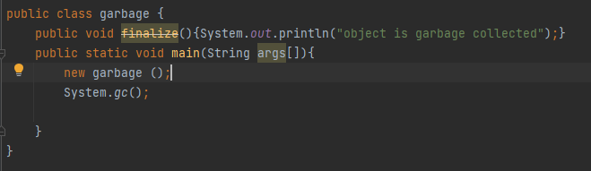
Finalization
Ways for making objects eligible for collection
Using anonymous objects

Slide 15
Arrays
Arrays are used to store multiple values in a single variable, instead of declaring separate variables for each value.
To declare an array, define the variable type with square brackets:
String[] cars;
We have now declared a variable that holds an array of strings. To insert values to it, you can place the values in a comma-separated list, inside curly braces:
String[] cars = {"Volvo", "BMW", "Ford", "Mazda"};
To create an array of integers, you could write:
int[] myNum = {10, 20, 30, 40};

Slide 16
Arrays
Access the Elements of an Array
You can access an array element by referring to the index number.
This statement accesses the value of the first element in cars:
Example
String[] cars = {"Volvo", "BMW", "Ford", "Mazda"};
System.out.println(cars[0]);
Array Length
To find out how many elements an array has, use the length property:
Example
String[] cars = {"Volvo", "BMW", "Ford", "Mazda"};
System.out.println(cars.length);
// Outputs 4

Slide 17
Arrays
Loop Through an Array
You can loop through the array elements with the for loop, and use the length property to specify how many times the loop should run.
The following example outputs all elements in the cars array:
Example
String[] cars = {"Volvo", "BMW", "Ford", "Mazda"};
for (int i = 0; i < cars.length; i++) {
System.out.println(cars[i]);
}

Slide 18
Arrays
Loop Through an Array with For-Each
There is also a "for-each" loop, which is used exclusively to loop through elements in arrays:
Syntax
for (type variable : arrayname) {
...
}
If you compare the for loop and for-each loop, you will see that the for-each method is easier to write, it does not require a counter (using the length property), and it is more readable.

Slide 19
Arrays
Multidimensional Arrays
A multidimensional array is an array of arrays.
To create a two-dimensional array, add each array within its own set of curly braces:
Example
int[][] myNumbers = { {1, 2, 3, 4}, {5, 6, 7} };
Access Elements
To access the elements of the myNumbers array, specify two indexes: one for the array, and one for the element inside that array. This example accesses the third element (2) in the second array (1) of myNumbers:
Example
int[][] myNumbers = { {1, 2, 3, 4}, {5, 6, 7} };
System.out.println(myNumbers[1][2]); // Outputs 7

Slide 20
Arrays
Multidimensional Arrays
Loop Through a Multi-Dimensional Array: We can also use a for loop inside another for loop to get the elements of a two-dimensional array:
public class Main {
public static void main(String[] args) {
int[][] myNumbers = { {1, 2, 3, 4}, {5, 6, 7} };
for (int i = 0; i < myNumbers.length; ++i) {
for(int j = 0; j < myNumbers[i].length; ++j) {
System.out.println(myNumbers[i][j]);
}
}
}
}

Slide 21
Array of Objects
Circle[] circleArray = new Circle[10];
An array of objects is actually an array of reference variables. So invoking circleArray[1].getArea() involves two levels of referencing as shown in the next figure. circleArray references to the entire array. circleArray[1] references to a Circle object.

Slide 22
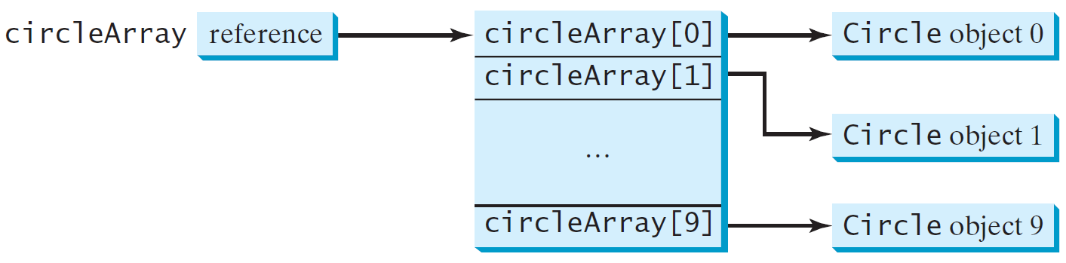
Array of Objects
Circle[] circleArray = new Circle[10];

Slide 23
Array of Objects
To initialize circleArray, you can use a for loop
for (int i = 0; i < circleArray.length; i++) {
circleArray[i] = new Circle();
}
An array of objects is actually an array of reference variables.
When an array of objects is created using the new operator, each element in the array is a reference variable with a default value of null.

Slide 24
Array Limitations
Fixed-size
Adding or removing from middle is hard

Slide 25
The ArrayList Class
The ArrayList class is part of the java.util package.
An ArrayList is like an array, but it automatically grows and shrinks as elements are added or deleted (so, there are never ANY empty elements in an ArrayList).
Items can be inserted or removed with a single method call.
It stores references to the Object class, which allows it to store ANY kind of object – so, you can store different types in the same array.

Slide 26
The ArrayList Class
However, this means that you cannot store primitive types (int, double, char, boolean) in an ArrayList. Instead, you would store their Wrapper Class equivalents:
Integer
Double
Character
Boolean

Slide 27
ArrayList
Import java.util.ArrayList
ArrayList is a class, so you must instantiate an object of it
Commonly used ArrayList methods:
add (obj) // adds obj at the end of the list
add (index, obj) // adds obj at the specified index
set (index, obj) // replaces the value at the specified index with obj
get (index) // returns the object at the specified index
indexOf(obj) // finds the index of the specified obj
remove (index) // deletes the object at the specified index
size ( ) // returns the size of the ArrayList

Slide 28
Type parameters (generics)
ArrayList<Type> name = new ArrayList<Type>();
When constructing an ArrayList, you must specify the type of its elements in < >
This is called a type parameter ; ArrayList is a generic class.
Allows the ArrayList class to store lists of different types.
Arrays use a similar idea with Type[]
ArrayList<String> names = new ArrayList<String>();
names.add("Marty Stepp");
names.add("Stuart Reges");

Slide 29
Restricting the values in an Arraylist
By default, an ArrayList can store any type of Object.
You can, if you wish, restrict the type of thing that an ArrayList can hold, by using the < > symbols. This is called using generics.
Examples:
1) ArrayList<Person> z = new ArrayList<Person>();
2) ArrayList<Integer> x = new ArrayList<Integer>();

Slide 30
ArrayList vs. array
String[] names = new String[5]; // construct
names[0] = "Jessica"; // store
String s = names[0]; // retrieve
for (int i = 0; i < names.length; i++) {
if (names[i].startsWith("B")) { ... }
} // iterate
ArrayList<String> list = new ArrayList<String>();
list.add("Jessica"); // store
String s = list.get(0); // retrieve
for (int i = 0; i < list.size(); i++) {
if (list.get(i).startsWith("B")) { ... }
} // iterate

Slide 31
ArrayList as param/return
public static void name(ArrayList<Type> name) {// param
public static ArrayList<Type> name(params) // return
Example:
// Returns count of plural words in the given list.
public static int countPlural(ArrayList<String> list) {
int count = 0;
for (int i = 0; i < list.size(); i++) {
String str = list.get(i);
if (str.endsWith("s")) {
count++;
}
}
return count;
}

Slide 32
Implementing add
How do we add to the end of a list?
public void add(int value) { // just put the element
list[size] = value; // in the last slot,
size++; // and increase the size
}
list.add(42);
index | 0 | 1 | 2 | 3 | 4 | 5 | 6 | 7 | 8 | 9
value | 3 | 8 | 9 | 7 | 5 | 12 | 0 | 0 | 0 | 0
size | 6
index | 0 | 1 | 2 | 3 | 4 | 5 | 6 | 7 | 8 | 9
value | 3 | 8 | 9 | 7 | 5 | 12 | 42 | 0 | 0 | 0
size | 7

Slide 33
Implementing remove
Again, we need to shift elements in the array
this time, it's a left-shift
in what order should we process the elements?
what indexes should we process?
list.remove(2); // delete 9 from index 2
index | 0 | 1 | 2 | 3 | 4 | 5 | 6 | 7 | 8 | 9
value | 3 | 8 | 9 | 7 | 5 | 12 | 0 | 0 | 0 | 0
size | 6
index | 0 | 1 | 2 | 3 | 4 | 5 | 6 | 7 | 8 | 9
value | 3 | 8 | 7 | 5 | 12 | 0 | 0 | 0 | 0 | 0
size | 5

Slide 34
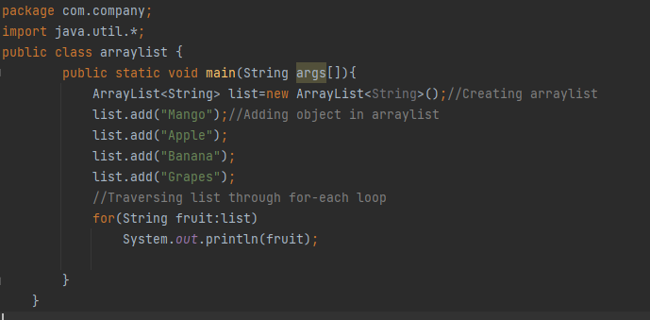

Some Examples

Slide 35
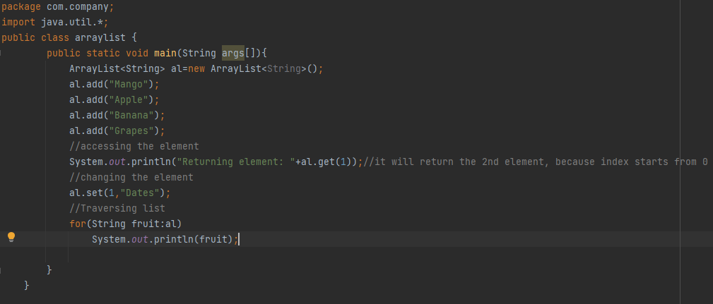

Some Examples (Get and Set ArrayList)

Slide 36
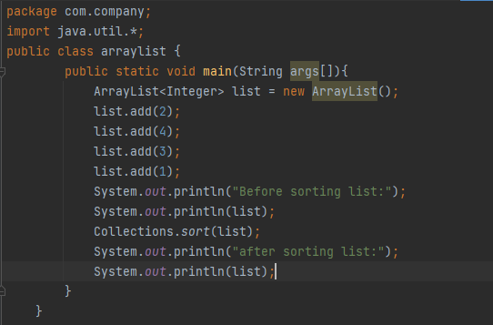

Some Examples (How to Sort ArrayList)

Slide 37
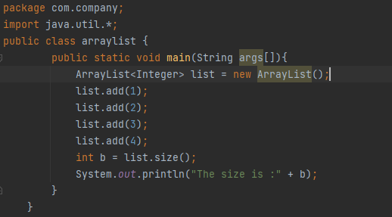

Some Examples (Size of elements)

Slide 38
Assignment (NamesArray)
Ask the user how many names they will enter.
Then ask for those names, storing them in an ArrayList. Display the list.
Ask the user to choose one of the names. Delete this person from the list. Display the list.
Insert your own name so that it’s the 2nd name in the list. Display the list.
Then add the name “Mike Gordon” to the end of the list. Display the list.
Then, ask the user to choose another name to delete, as well as what name will replace it. Replace the name. Display the list.
Then, ask how old each person on the list is (ex: “How old is Mike Gordon?”). Insert each person’s age immediately after that person’s name in the List. Display the list.

Slide 39
Scope of Variables
In programming, a variable can be declared and defined inside a class, method, or block. It defines the scope of the variable i.e. the visibility or accessibility of a variable. Variable declared inside a block or method are not visible to outside. If we try to do so, we will get a compilation error.
We can declare variables anywhere in the program but it has limited scope.
A variable can be a parameter of a method or constructor.
A variable can be defined and declared inside the body of a method and constructor.
It can also be defined inside blocks and loops.
Variable declared inside main() function cannot be accessed outside the main() function

Slide 40
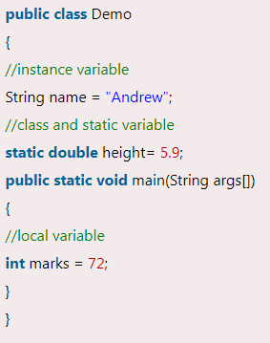
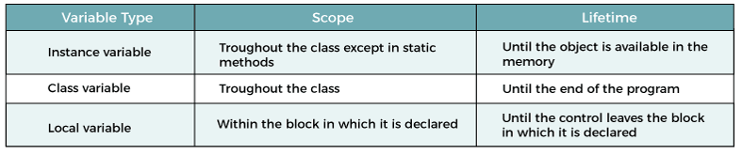
Scope of Variables

Slide 41
Scope of Variables
The scope of instance and static variables is the entire class. They can be declared anywhere inside a class.
The scope of a local variable (i.e. a variable defined in a method) starts from its declaration and continues to the end of the block that contains the variable.

Slide 42
Scope of Variables
In Java, there are types of variables based on their scope
Member Variables (Class Level Scope)
Local Variables (Method Level Scope)
Member Variables (Class Level Scope)
These are the variables that are declared inside the class but outside any function have class-level scope. We can access these variables anywhere inside the class. Note that the access specifier of a member variable does not affect the scope within the class.

Slide 43
Scope of Variables
Local Variables (Method Level Scope)
These are the variables that are declared inside a method, constructor, or block have a method-level or block-level scope and cannot be accessed outside in which it is defined. Variables declared inside a pair of curly braces {} have block-level scope.

Slide 44
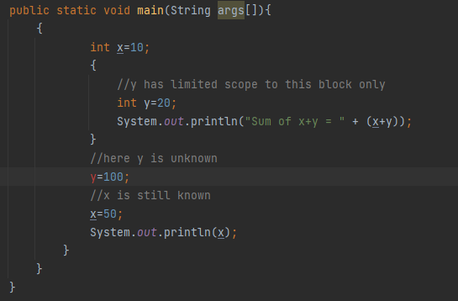
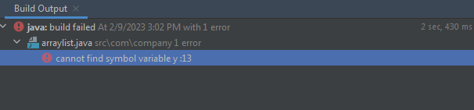
Scope of Variables
Example:

Slide 45
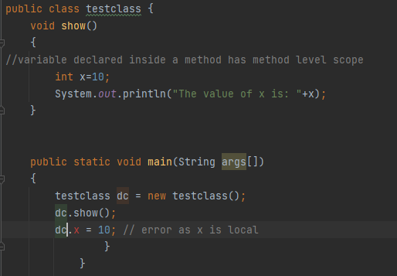
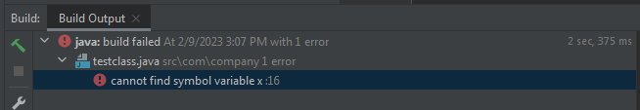
Scope of Variables
Example:

Slide 46
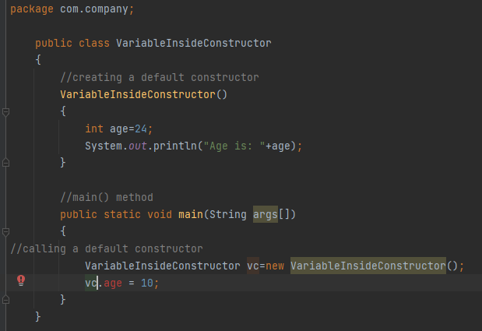
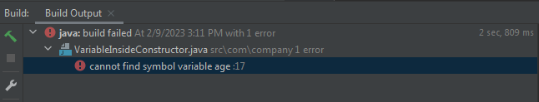
Scope of Variables
Declaring a Variable Inside a Constructor

Slide 47
Scope of Variables
Declaring a Variable Inside a Constructor

Slide 48
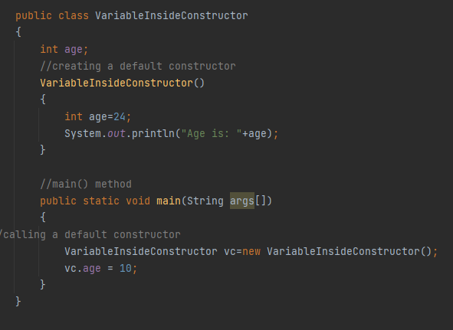
Scope of Variables
Declaring a Variable Inside a Constructor
Can redeclare a variable with same name as age inside constructor is local.

Slide 49
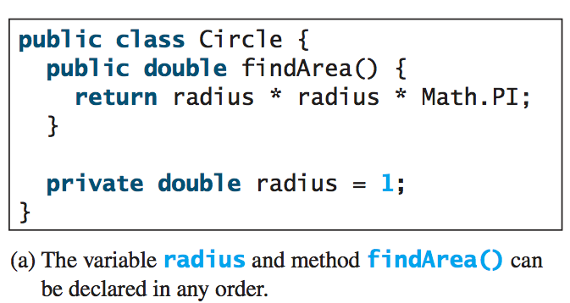
Scope of Variables

Slide 50
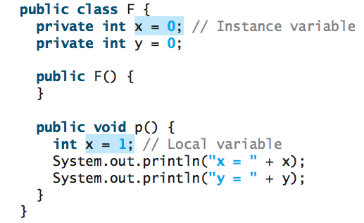
Scope of Variables
If a local variable has the same name as a class’s variable, the local variable takes precedence and the class’s variable with the same name is hidden.

